Slide 1

COD 310 mid-term presentation Landscape Level Impact Assesment
By: Mani Sarthak
Supervisor: Prof. Aaditeshwar Seth

Slide 2
Work done till now
Automating the data scrapping process for the website indiawris.gov.in
Analysing the data ie. Density, correctness, level-wise analysis.

Slide 3
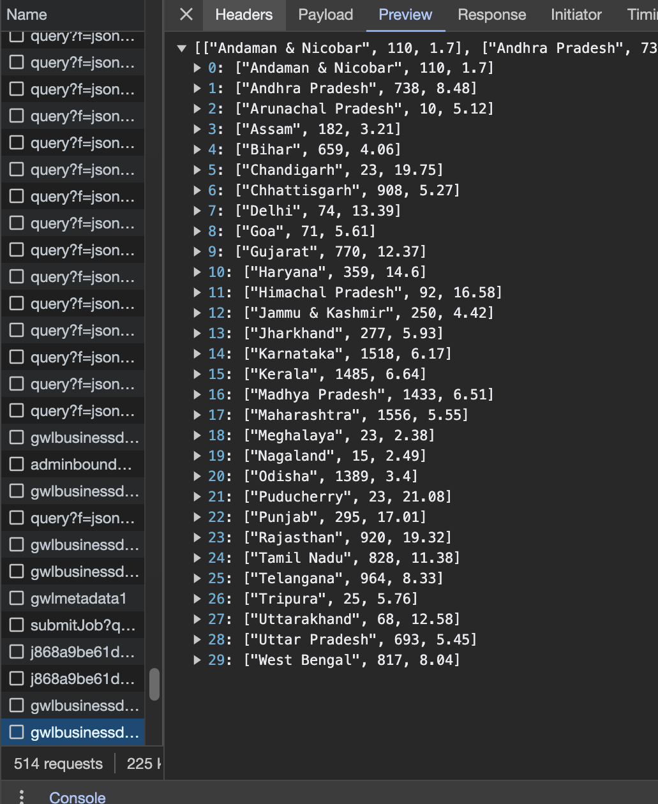
Website hirearchy: how the data is organized?
State level

Slide 4
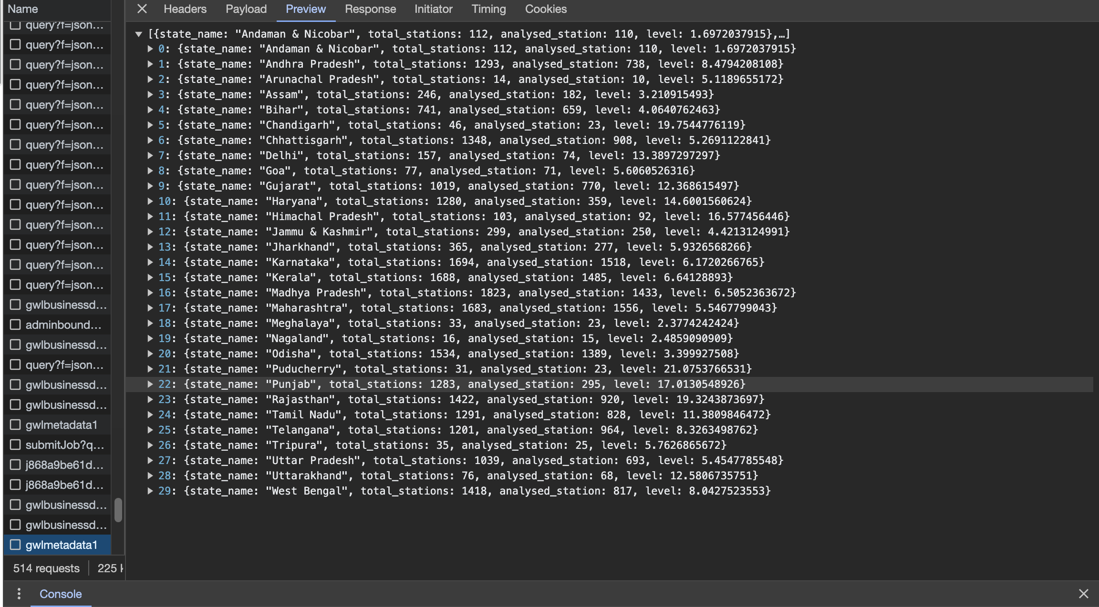
Website hierarchy: how the data is organized?
State level

Slide 5
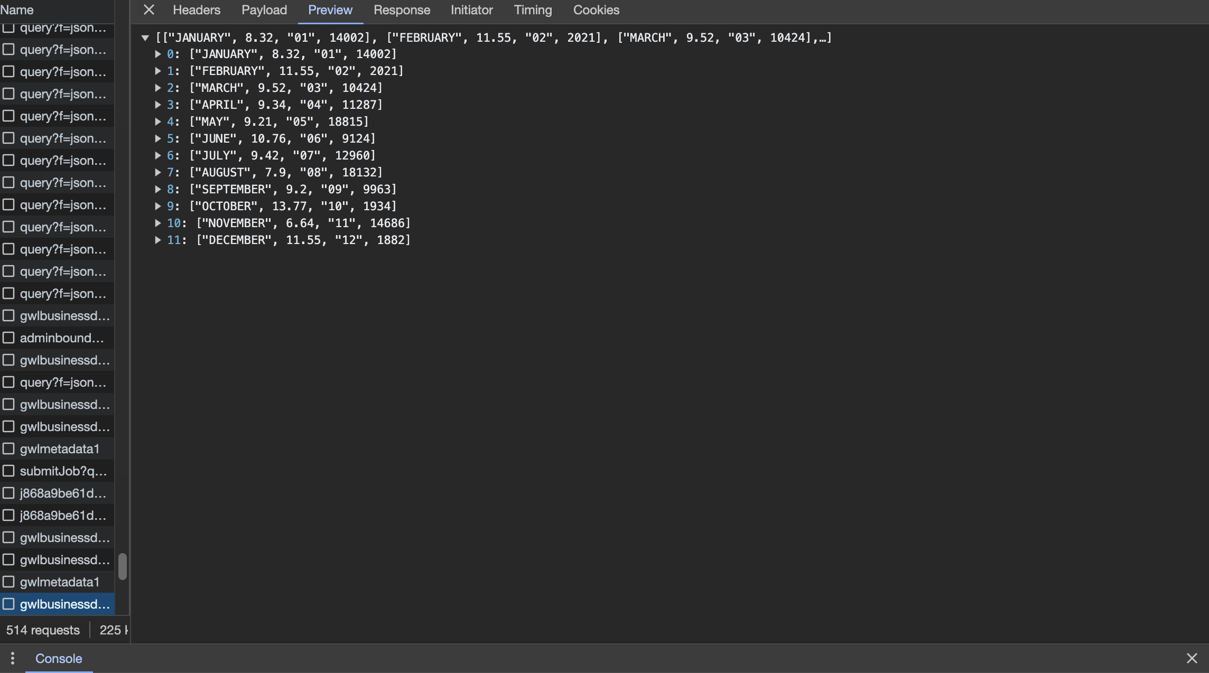
Website hirearchy: how the data is organized?
State level

Slide 6
Summary of data organisation
Upon opening the website all information is arranged in two types of hierarchy namely state wise and then year wise (12 most recent months).
All important information is contained in the fetch requests with the name `gwlbusinessdata`.
The method for fetching the `gwlbusinessdata` is using POST method.
To automate the process of Scrapping need to crack the headers of the POST request !!
Final organization: year -> state -> district -> seasonally and yearly

Slide 7
Cracking the POST method request
Used browsers like Chrome Canary and Firefox that allows for better inspect methods.
Used the web apps like POSTMAN, HTTP Toolkit etc.
Analysed JavaScript and website HTML code to see which things are triggered when the download button is clicked.
Used apps like Wireshark to track the requests sent to the website.
Based on knowledge of working of website created a small requests parsing script using sockets to get the data directly.
Tried getting data from selenium library using chromedriver.

Slide 8
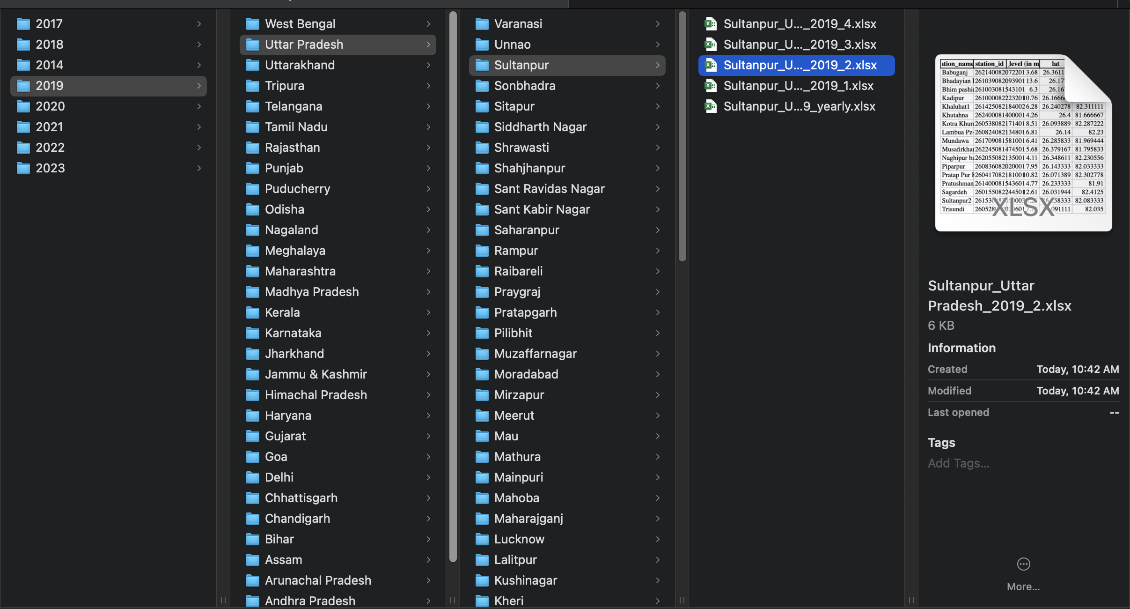
Result: Process automated totally !

Slide 9
How data is fetched finally?
Copied the POST method request using cURL.
Now data can be retrieved from the website as expected using python requests library.
After that parsing and organising the data in excel (or csv) was easy.
The data received from the website didn’t had the lat-long along with the station_id.
A new script to fetch the lat-long and then integrate it with the previously fetched data.
Final data format -> (well_name, well_id, water_level, lat, long).

Slide 10
Challenges faced while fetching
The time for fetching a single year (500+ districts * 5 datasets/district) is around 7 hrs if considering program is running continuously.
The sever is slow, takes much more time to fetch the data.
The server breaks the connection and blocks the IP if many requests are fetched from a single host. Either change location or hotspot to change the IP.
Implemetation: Running the scripts on 6 different hosts which are coordinating among them for getting yearwise data.

Slide 11
Analysing the data
The data obtained can be obtained from the website in many different levels like day wise, month wise, season wise, year wise.
Of them day wise and month wise data are very sparse.
The stations measured are changing over the years (are decreasing too in some states).
In a given year, during the seasons some wells are measured and some are not.
States themselves have changed over the years eg. Telangana.

Slide 12
References
All the scripts are maintained on my GitHub.
The data downloaded is here.

Slide 13
Thank You

